Slide 1


FPT SOFTWARE HO CHI MINH CITY VIET NAM NATIONAL UNIVERSITY HO CHI MINH CITY UNIVERSITY OF SCIENCE
REPORT MOCK PROJECT
WHEELCHAIR ACCIDENT DETECTOR
WAD
Group 4
Ho Chi Minh City, August 13th, 2018.

Slide 2
CONTENT
1. PROBLEM
2. OVERVIEW PROJECT
3. OPERATING PRINCIPLE
4. DEMO
5. CONCLUSION

Slide 3
CONTENT
1. PROBLEM
2. OVERVIEW PROJECT
3. OPERATING PRINCIPLE
4. DEMO
5. CONCLUSION

Slide 4


1. PROBLEM
Supervising and supporting on time

Slide 5
CONTENT
1. PROBLEM
2. OVERVIEW PROJECT
3. OPERATING PRINCIPLE
4. DEMO
5. CONCLUSION

Slide 6
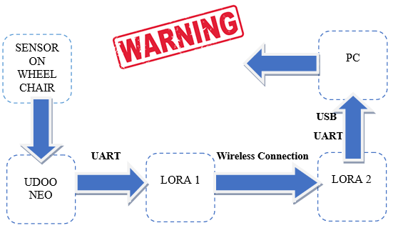
2. OVERVIEW PROJECT

Slide 7
CONTENT
1. PROBLEM
2. OVERVIEW PROJECT
3. OPERATING PRINCIPLE
4. DEMO
5. CONCLUSION

Slide 8
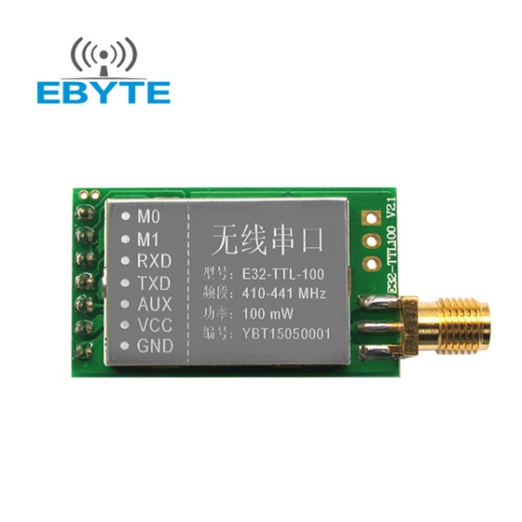
3. OPERATING PRICIPLE
HARDWARE
Module Lora SX1278
Module size:21*36mm
Antenna type: Standard SMA antenna (FREE)
Power supply:2.3V-5.5V DC
Communication level:5.2V(max)
Transmission distance:3000m(max)
Maximum powAer:2dB(100mW)
Air rates:2.4Kbps
Emission current:130mA @ 100mW
Receiving current:13.5mA @ Mode 0, Mode 1
Sleep Current:2.0uA(M1=1,M1=0)
Emission length:256 Byte
Receive length:256 Byte
Communication Interface: UART
RSSI support: Yes
Working frequency:410MHz-441MHz(Default 433MHz)
Operating temperature:-30?~+85?
Receiver sensitivity:-130dBm @ 1.2Kbps

Slide 9
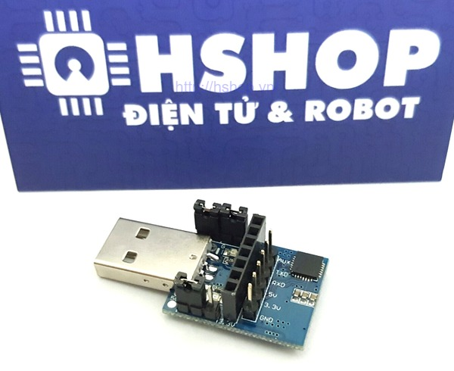
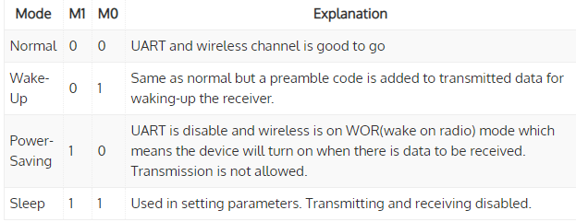
3. OPERATING PRICIPLE
HARDWARE
USB UART Lora SX1278 Transmission
Modes of the module

Slide 10
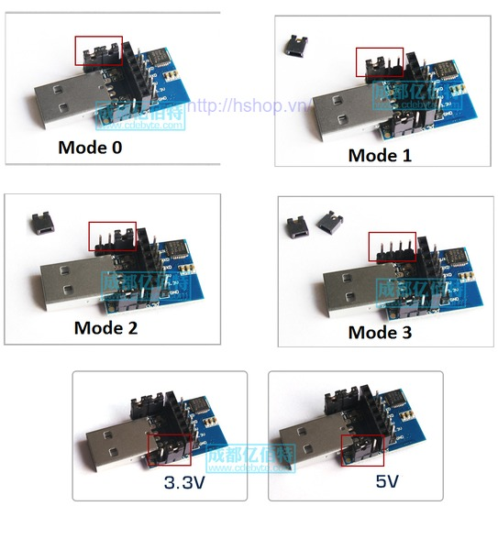
3. OPERATING PRICIPLE
HARDWARE
Configuring Modes

Slide 11
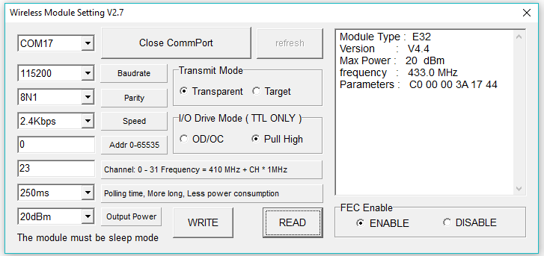
3. OPERATING PRICIPLE
HARDWARE
Connection Lora with PC and microcontroller

Slide 12
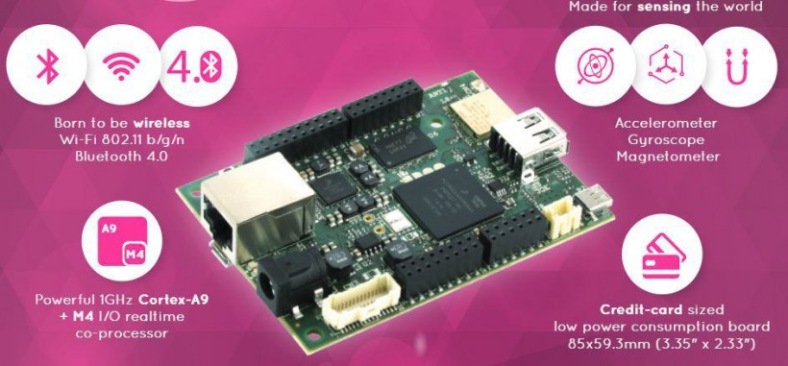
3. OPERATING PRICIPLE
HARDWARE
https://www.udoo.org/docs-neo/Introduction/Introduction.html

Slide 13
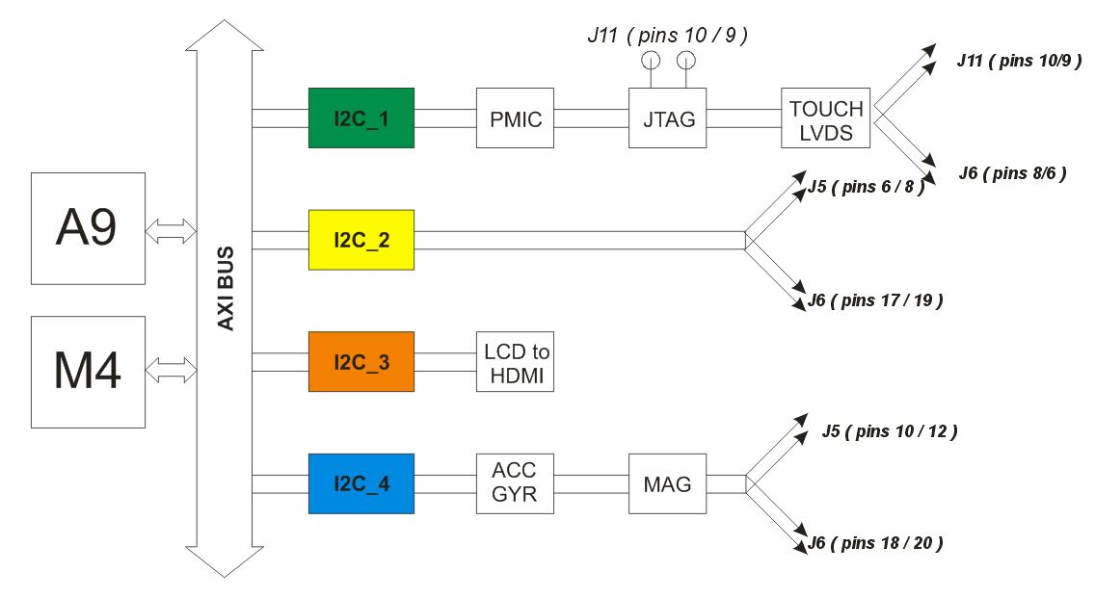
3. OPERATING PRICIPLE
HARDWARE
UDOO Neo Motion Sensor

Slide 14
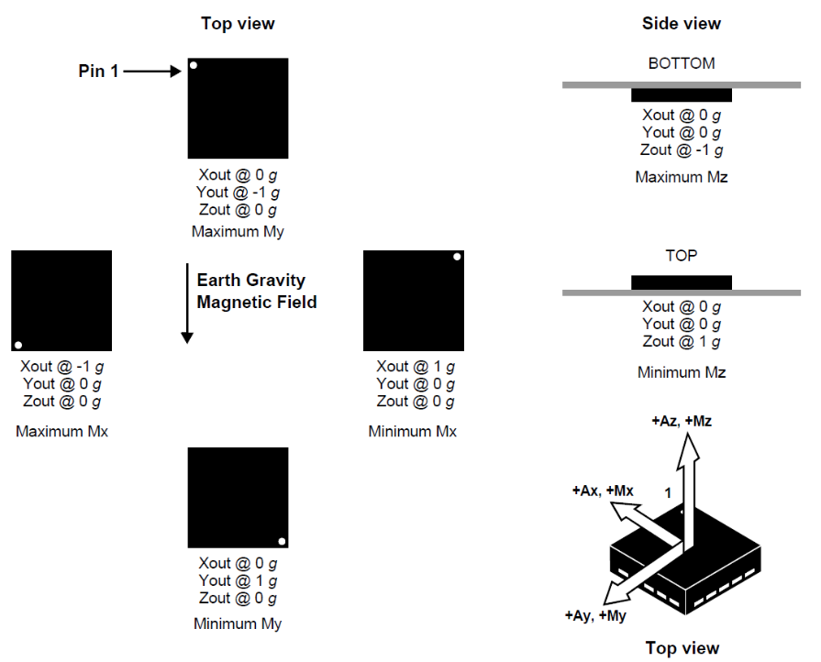
3. OPERATING PRICIPLE
HARDWARE
Accelerometer and Magnetometer: FXOS8700CQ
I2C address: 0x1E
Small
Low-power
3-axis linear accelerometer
3-axis magnetometer
I2C with 14-bit accelerometer and 16-bit

Slide 15
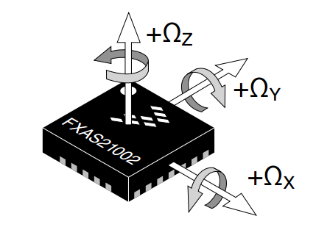
3. OPERATING PRICIPLE
HARDWARE
Gyroscope: FXAS21002C
I2C address: 0x20
Small
Low-power
Yaw, pitch, and roll angular rate gyroscope with 16 bit ADC resolution

Slide 16
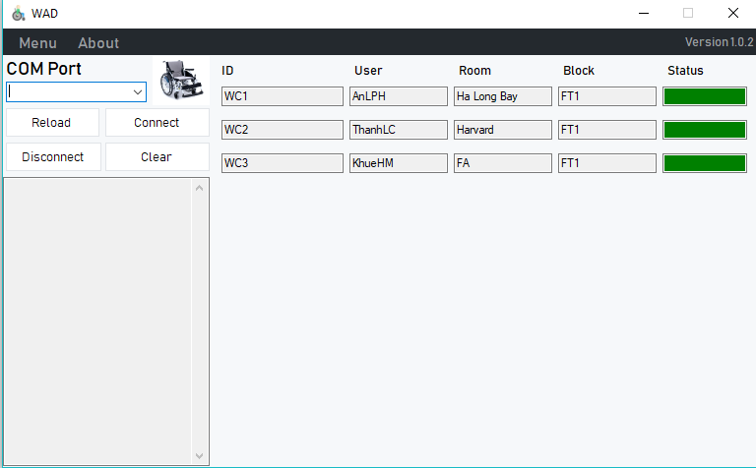
3. OPERATING PRICIPLE
SOFTWARE

Slide 17
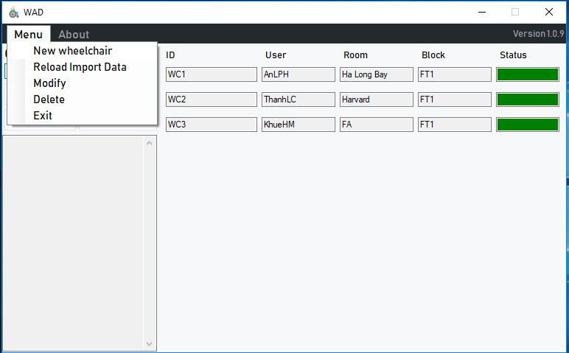
3. OPERATING PRICIPLE
SOFTWARE

Slide 18
CONTENT
1. PROBLEM
2. OVERVIEW PROJECT
3. OPERATING PRINCIPLE
4. DEMO
5. CONCLUSION

Slide 19
4. DEMO

Slide 20
CONTENT
1. PROBLEM
2. OVERVIEW PROJECT
3. OPERATING PRINCIPLE
4. DEMO
5. CONCLUSION

Slide 21
5. conclusion
ADVANTAGES
Light weigth
Saving Energy
Easy to use
Wide range
DIFFICULTIES
High price
Accuracy is not high

Slide 22
Q&A

Slide 23
THANKs FOR LISTENING

